Slide 1
Person
Persons respond to economic incentives through the actions of…
Migration
Voting
Seeking employment opportunities
How and which actions are undertaken is determined by happiness, which is a function of utility obtained from…
Social ties
Political freedom
Income
Job satisfaction

Slide 2
Person
Happiness
Form social ties
Start
Voting
Migration and Employment
End

Slide 3


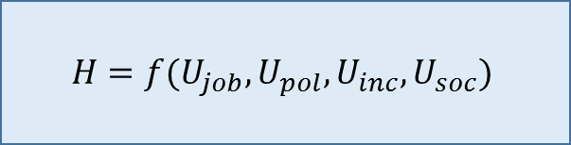
Happiness
U_{income}
$I_{j}$≡ income of j^{th} person, $\overline{I}$ ≡ mean inc. , $C$ ≡ cost of living in city of residence
If $I_{j}<C$:
$$U_{inc}=1−\frac{C−I_{j}}{C}$$
Else if $I_{j}≥\overline{I}$:
$$U_{inc}=1$$
Else:
$$U_{inc}=1−\frac{\overline{I}−I_{j}}{\overline{I}}$$
U_{social}
Start
Function of # of friend and family nodes (FFN) in same city. All persons start with >0 FFN in city of origin. Every tick, each person may probabilistically add a FFN in the city of residence.
Happiness
$$H=f(U_{job}, U_{pol}, U_{inc},U_{soc})$$
U_{political}
U_{job}
Normalized democracy score of country of residence
If unemployed:
$$U_{job}=0$$
Else:
$$U_{job}=1−\frac{\left|edu_{person}−edu_{job}\right|}{max edu gap}$$
End

Slide 4
Voting
Start
Simple
Vote…
Incumbent w/ Pr(H),
Challenger w/ Pr(1-H)
Citizen of country of residence?
Realistic
End
Evaluate…
own position on immigration
each candidate’s position
Vote candidate w/ closest position
Selection Rule

Slide 5
Policy Preference
Realistic
Start
Evaluate…
own position on immigration
each candidate’s position
Vote candidate w/ closest position
Everyone has exogenously set preference to begin N~(50, 10). If move to foreign country, redraw N~(75, 7)
Citizen of country of residence?
End
Selection Rule

Slide 6

Migration and Employment
Migrate
Get candidate cities
Estimate expected value of each
$$EV(city_{i})=f(Pr⁡(deport),cost of move, avg wage, E(duration of stay))$$
Quit current job
Remove pending applications
Move to new city
Undertake condition change with Pr(H)
Start
NEED CHANGE
STATUS QUO
YES
Apply Jobs Locally
Not migrated lately AND unemployed for some time
End
Apply to all job openings with required education level in proximity to own
NO

Slide 7
City
The city is primarily an aggregation of persons
Each city has…
…an associated economy
…a discrete location, enabling calculation of distance to other cities
…a cost of living which impacts residents’ happiness and therefore sustainment in the city
…a pool of legislators, both in and out of office, and seats in the legislature

Slide 8
Country
The country is primarily an aggregation of cities
Each country has…
…an associated economy, which is a wrapper for the economies of its constituent cities.
…a legislature comprised of legislators from member cities.
…an immigration policy comprised of:
probability of deportation: probability that a migrant from a foreign country will be involuntarily returned to the country of origin
cost of entry: amount added to a person’s cost of moving when migrating in from a city in a different country

Slide 9
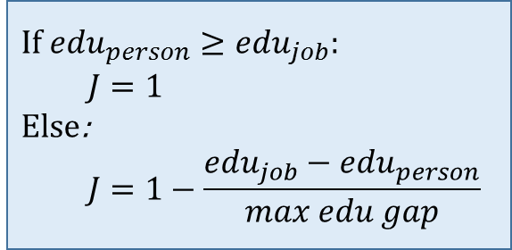
Job
Filled?
Has applicants?
Start
NO
NO
YES
YES
Hire
End
Hire an applicant at random
Job Performance
If $edu_{person}≥edu_{job}$:
$$J=1$$
Else:
$$J=1−\frac{edu_{job}−edu_{person}}{max edu gap}$$
Terminate
Terminate with Pr( 1 - J )

Slide 10
Legislator
Each city has a preset pool of X legislators and Y seats in the legislature, where Y < X. All X legislators compete for all Y seats at every election.
Elections are held at a fixed interval, and are decided by SNTV (because it is simple to implement).
All legislators vote on the single issue dimension of immigration
All legislators vote sincerely

Slide 11
Legislature
Each country has a unicameral legislature comprised of a multiplicity of legislators
A legislature’s chamber median determines immigration policy for its respective country.
The chamber median is calculated on or after each election for legislators.

